Slide 1
MPG
PWM

Slide 2
Housekeeping
Attendance
Next weeks:
SD Card (file system)
Text Editor
Radio (ANT)
PC-Lint (makefiles)
End Project

Slide 3
What is PWM?
Pulse Width Modulation
Digital systems can only express two voltage states: high (1) and low (0).
Real world is analog …
Digital-to-Analog Conversion (DAC) can get some form of analog – but only at discrete levels
Digital processor can only create square waves … but many systems can be modulated to give the appearance of analog voltages this way

Slide 4
PWM Applications
We can only see 10-30 Hz.
If we blink an LED at 30 Hz, 50% duty cycle, it will appear as if it is running at half voltage (half as bright)
Capacitance helps to smooth out the voltage
Switching Power supplies convert the high input voltage down to a regulated lower voltage
Motor controllers
Dimmer Switches

Slide 5
PWM Basics
Blinking an LED is a square wave (i.e. on for 500ms, off for 500ms = 1Hz, 50% duty cycle)

Slide 6
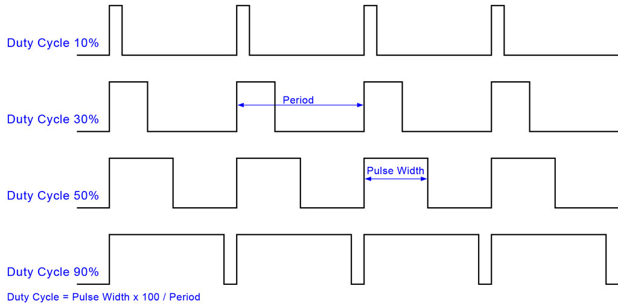
PWM Basics

Slide 7
PWM Exercise
Program an LED on PWM at 100 Hz
Left button = 10% duty cycle
Right button = 90% duty cycle
else 50% duty cycle
Then try adjusting the frequency to 50 Hz, and 30 Hz. Do you see any flicker?

Slide 8
MPG Hardware
Notes:
Buzzer 1 = Channel 0
Buzzer 2 = Channel 1
Current board can only use one beeper at a time… unless you rewire the ground

Slide 9
PWM Peripheral
4-channel, 16-bit
Can set period, duty-cycle, polarity, alignment and dead-times
Each channel can use a different clock
All channels integrate double-buffering in order to prevent an unexpected waveform while modifying the period, duty-cycle or dead-times
Channels can be linked together
Duty cycle can be written by DMA
Interrupts from various comparisons (i.e. to trigger an ADC, or a DMA transfer)

Slide 11
PWM Peripheral
PWMC_ENA = enable PWM channels
PWMC_CMR = mode register (clock, alignment, polarity, dead-time)
PWMC_CPRDR / PWMC_CPRDUPDR = period (in PWM clock ticks)
PWMC_CPCDTYR / PWMC_CDTYUPDR = duty cycle (in PWM clock ticks)

Slide 12
AT91C_BASE_PWMC->PWMC_ENA = xxx

Slide 13
(MCK = 48 MHz)
PWMC_CH[n].PWMC_CPRDR = xxx

Slide 14
PWMC_CH[n].PWMC_CDTYR = PWMC_CH[n].PWMC_CPRDR * (duty/100)

Slide 15
PWM Peripheral
CPRDR vs CPRDUPDR & CPCDTYR vs CDTYUPDR
Use the direct registers when PWM is off
Use the update registers when PWM is already running… why?

Slide 16
PWM Peripheral > To Beeper API
BeeperInit()
basic configuration, variable setup, etc.
BeeperOn(frequency, duty, whichBeeper)
BeeperOff(whichBeeper)
?
?

Slide 17
void BeeperOn(freqHz, beeperNum)
periodTicks = 48MHz / freqHz;
if (channel is running)
CPRDUPDR = periodTicks;
CDTYUPDR = periodTicks / 2;
else
BspPeriphOn();
CPRDR = periodTicks;
CDTYR = periodTicks / 2;
PWMC_ENA = _BIT(beeperNum);

Slide 18
void BeeperOff(beeperNum)
Gpio – switch from peripheral control to direct control and drive low
PWMC_DIS = _BIT(beeperNum);
if (all channels disabled)
BspPeriphOff()

Slide 19
What to do with the beeper?
Musical notes
A5 = 440 Hz
1 octave up = double the frequency
lib\utils\notes.h
Simple song:
BeeperOn(440);
TimerWaitXMs(100);
BeeperOn(880);
…

Slide 20
You’re Turn!
https://xp-dev.com/svn/MPG/SAM3U/MPGL1/Exercises/PWM
main.c: Four different calls to the exercise functions:
Exercise 1: Manual PWM control of LED
Exercise 2: Basic Beeper Control
Exercise 3: Beeper Sweep
Exercise 3: Make a song

